Slide 1
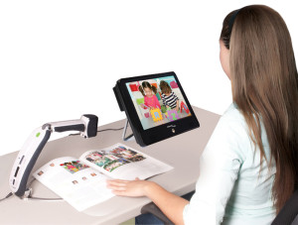
Assistive Technology (AT) and the IEP:
A brief guide for families
Washoe County School District
AT Team

Slide 2
Who am I??
Special Education teacher by heart and education – 25 years
Bachelor’s in Elementary and Special Education; Master’s in Curriculum and Instruction
Assistive Technology Specialist
Adjunct Faculty – University of Nevada, Reno
Special Education Mentor for New Teacher Center
Former State Board Member: Nevada Governor’s Council on Developmental Disabilities, Special Education Advisory Committee and Interagency Transition Advisory Board
Advocate for PWDs
Zac’s Mom

Slide 3
Today’s Agenda…
AT in our schools - video
AT and the law
AT and the IEP
AT consideration and decision making process
Resources for everyone
Q and A

Slide 4
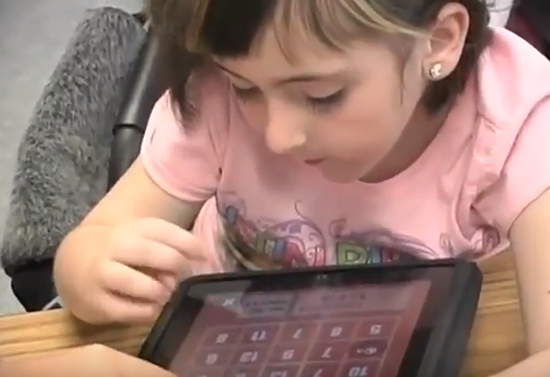
21st Century Learning - WCSD
Pilot Project – WCSD Assistive Technology Team
Created to show what students with complex needs CAN do, to raise expectations, and show how necessary technology in the special education classroom is to student success
Video used nationally to create awareness and to assist with grant funding
  https://vimeo.com/71289462
  CC: https://www.youtube.com/watch?v=XF4LJyEKPVQ

Slide 5

School districts must provide AT to students who require devices and services
IDEA Section 300.105:
  Each public agency shall ensure that assistive technology devices and assistive technology devices and services, or both, as those terms are defined in Sections 300.5 and 300.6, are made available to a child with a disability if required as a part of the child’s —
    Special education under Section 300.36;
    Related services under Section 300.34; or
    Supplementary aids and services under Section 300.38 and 300.114(a)(2)(ii).

Slide 6

IEP Teams must consider AT:
IDEA regulations part C: Sec. 300.346 Development, review, and revision of IEP:
  “Consider whether the child requires assistive technology devices and services”
AT must be considered for every student with an IEP
  When considering AT, the IEP Team must consider "the student's functional capabilities and whether they may be increased, maintained, or improved through the use of [AT] devices or services."[
      OSEP Policy Letter to J. Fisher, 23 IDELR 565 (12/4/95)

Slide 7
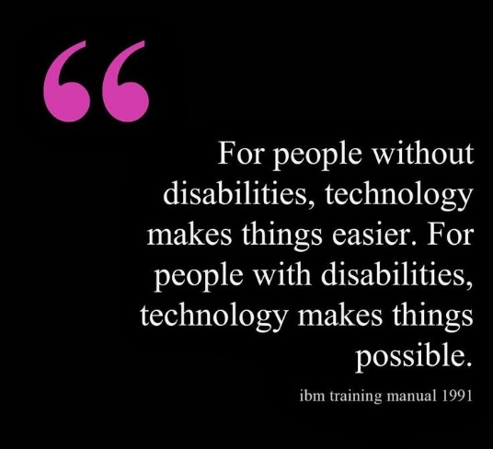
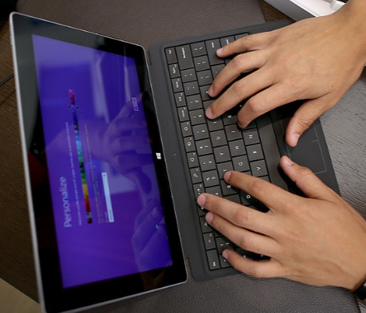
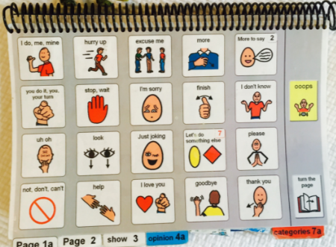
What are Assistive Technology devices and services?
Assistive Technology (AT) services are those that help students and teams select and utilize AT supports
  Including but not limited to evaluation of need, purchasing, customizing, designing, repairing, maintaining, training, technical assistance (IDEA 2004)
Assistive Technology devices and services are provided when necessary for a child to receive a Free and Appropriate Education (FAPE) and access the Least Restrictive Environment (LRE)

Slide 8

AT devices – guidelines simplified….
Assistive Technology (AT) devices, whether low-tech or high-tech, are provided to allow students to complete tasks they would not otherwise be able to complete (increase, maintain, improve functional capabilities)
Assistive technology is often utilized to provide AEM (Accessible Educational Materials)

Slide 9

AEM – Accessible Educational Materials
All educational materials must be accessible to EVERYONE
  Accessible educational materials, or AEM, are materials and technologies usable for learning across the widest range of individual variability, regardless of format or features
    www.aem.cast.org
Bookshare
  www.bookshare.org

Slide 10

Writing AT in the IEP
  Present Levels
  Consideration of Special Factors
  Goals and Objectives
  Supplementary Aides and Services
  Related Services

Slide 11

Present Levels
An IEP for a student requiring AT devices or services must include a statement about AT
Present Levels should describe the NEED for a device or a service in specific terms
  Example: describe difficulties with communication, writing, reading, or accessibility for which AT devices/services may be required

Slide 12
Present Levels…continued….
Specific devices (no tech to high tech) that address the needs of the student should be described in Present Levels, once particular devices have been deemed appropriate and necessary
  Teams should be very cautious about listing specific devices in IEPs before appropriate consideration as this obligates IEP teams/LEA’s to provide such material and may hinder the AT decision making process
    Present Levels that reflect the student’s capabilities, barriers to completing tasks, learning environments and needs related to AT are useful to the consideration process
    Focusing first on the needs of a student rather than starting with a particular tool is best practice in AT decision making
  Once a device is deemed necessary, the IEP should be revised to include a description of the device and its use in the Present Levels
  Descriptions need to be adequate to understand the type of devices being used, including their particular necessary features, how the student utilizes them, and any support students require in the use of AT
  If materials are needed from the AT team, a referral to the team is necessary prior to writing specific devices in the IEP
    AT staff must be included in the consideration process to enable them to appropriately guide AT decision making and justify providing/purchasing devices for assessment and long term

Slide 13
Present Levels- an example of describing student need
Betsy exhibits a severe expressive communication impairment. She communicates with peers and adults using vocalizations, gestures, and a few single words. The team is currently using picture supports to aid in communication but are seeking an Assistive Technology Consultation to explore additional supports to enhance Betsy’s communication skills.
Johnny Jim is a 5th grade student demonstrating difficulty in the area of written expression. He requires access to word processing for all written assignments due to dysgraphia. Use of a portable computer for word processing is made available to him through the school site’s 1-to-1 technology program.

Slide 14

Consideration of Special Factors
Special Factors Question 2 requires consideration of AT:
  Basic consideration questions:
    Can the student complete tasks and reach goals with the commonly available resources, tools, and accommodations at the school site? (No AT as a related service)
    If the student may require AT, does the site team have the knowledge to make appropriate decisions and are the tools available at the school site? (AT needed – can be provided by school)
    Does the team need support with AT decision making and/or need access to tools not available the school? (AT needed – referral to AT team or other appropriate service provider such as audiology, vision, OT, PT)

Slide 15

Annual Goals and Objectives
AT may be included in goals and objectives where appropriate
Assistive technology is used to support students in reaching their goals and objectives
  AT is technology, no tech to high tech, used by a person with a disability for a functional purpose
  AT “assists” students in accomplishing tasks they might not otherwise accomplish
Teams should first develop goals for students, then add reference to any AT that may be necessary to achieve the goals

Slide 16
Goal- including a description of AT
Betsy will independently make statements, comments, and ask questions in 4 out of 5 opportunities using single word utterances, picture supports and/or a voice output communication device
Johnny Jim will produce a two paragraph essay, including an introduction, supporting details, and conclusion, given access to word processing

Slide 17

Supplementary Aides and Services
Assistive technology tools that have been deemed necessary should be described in the modification, accommodations, and supports
IEP teams should utilize descriptions of devices, include specific necessary features, rather than brand names
If teams identify particular devices through the AT consideration process that are appropriate for functional use assessment in the customary environment (I.e.: classroom), they may be listed in Supplementary Aides and services
  Timeframes for the functional assessment should be listed in the IEP
  IEPs should be revised to reflect outcomes

Slide 18
Descriptions of AT Supports
Content Area | Name of Selected Support | Examples for writing IEPs:
Written Expression | Co:Writer- Word prediction | Software supports for writing. Word processing with word prediction for writing assignments
Reading | Bookshare- Digital text | Accessible Educational Material- Electronic Text with Text-to-speech
Mathematics | Panther Math Paper app | Accessible electronic math worksheets
Communication | iPad with Proloqou2Go app | Dynamic display voice output communication device
    Please refer to “Assistive Technology as a Related Service in Easy IEP For Established AT students“ document for further guidance:
    http://www.washoeschools.net/cms/lib08/NV01912265/Centricity/Domain/278/AT%20%20Easy%20IEP%20Established%20Student%20Checklist%2011.16.pdf

Slide 19

Related Services
A variety of staff members support students in the selection and use of AT devices
Not all students who require AT devices require “Assistive Technology” as a related service in their IEP
Many AT tools are available at school sites to meet the needs of the students and site staff may have the knowledge required to make AT decisions and provide needed materials
Many related service providers such as OT, PT, Vision, and audiology also provide AT in addition to AT Specialists from the AT team
Adding “Assistive Technology” as a related service is only necessary when an IEP team requires the support of an AT Specialist to help with decision making, securing additional materials, or receiving specialized training
  AT is added as a “consult” so that an AT specialist can work with the site team to determine the scope of assistance needed and collaborate with staff and families to make on-going AT decisions

Slide 20
Scenario- Will the student require AT as a related service?
Johnny Jim is in the 5th grade and struggles with anything that involves paper/pencil activities and completing assignments. His school has a portable computer for every student. The team has decided to modify Johnny Jim’s assignments so he can use the portable computer for all his work.
Consideration of Special Factors – Check “yes” and make sure to make a statement of the AT in the IEP
Related Service – not required as school can meet the needs of the student

Slide 21
Scenario- Will the student require AT as a related service?
Betsy exhibits a severe expressive communication impairment. She communicates with peers and adults using vocalizations, gestures, and a few single words. The team is currently using picture supports to aid in communication but are seeking an Assistive Technology Consultation to explore additional supports to enhance Betsy’s communication skills.
Consideration of Special Factors – Check “yes” and make sure the need for AT is reflected in Present Levels
Related Service – add AT and make a referral to the AT team

Slide 22
The consideration process….
“Evaluation” should be an ongoing, collaborative, dynamic, functional, student centered process involving the entire team
  Example of student from California with a formal “assessment”
Best practice is to use the SETT model

Slide 23

S.E.T.T. Framework
SETT by Joy Zabala
Student
Environment
Task
Tool
**** Top down, not bottom up
****Shiny Object Syndrome

Slide 24
Student
Information about the person
  Strengths
  Weaknesses
  Likes
  Motivators
  Behaviors
  Special needs
  Motor and cognitive skills
  Previous experience with technology

Slide 25

Environment
Where does the person spend most of their day?
What technology does the school/class/agency/workplace currently have? (internet/wifi?)
How skilled is the staff that is working with the person in the areas of technology or AAC?
How many other students/people are there and how would you describe them?
What is the physical arrangement? Are there special concerns?

Slide 26

Tasks
.
What is it you want the person to do that he/she is not able to do now?
  Why would they want to do that anyway?
What are the other students/clients doing? (discrepancy analysis)
What would the person like to do that he/she is not able to do now? (interview/observe)
How might technology support the person’s active participation in those activities?
Note: You can’t modify it if it doesn’t exist

Slide 27

Tools (now we talk about the stuff)
What is available at the site/home?
What no tech, low tech and high tech options should be considered when developing a system for the person with these needs and abilities doing these tasks in these environments?
What strategies might be used to invite increased performance?
How might these tools be tried out with the person in the customary environments in which they will be used?

Slide 28

The WCSD AT Team is here to help (if you need it)!
The Assistive Technology (AT) Team assists IEP teams in making AT decisions and acquiring needed resources, materials, and training that may not be available at school sites
  Assistance may include:
    Guidance in the AT consideration process
    Support for IEP teams to assess the functional needs of students related to AT
    Selecting, procuring, designing, adapting, maintaining, customizing, or repairing AT tools ranging from no-tech to high-tech
    Coordinating with teachers, therapists, other professionals, or agencies regarding assistive technology devices and services
    Training and technical assistance for staff, students, and families
    Guidance for writing AT into IEPs

Slide 29

AT Teams….
A well balanced AT team will include professionals from several disciplines…
Speech/language pathologists are often leaders in assistive technology – especially when AAC (Alternate Augmentative Communication) is needed
Teachers and occupational therapists will also be providers of AT. Their focus may be more on Accessible Educational Materials, implementation and classroom accommodations
A good AT team has a balance of professionals…all members work in all areas

Slide 30
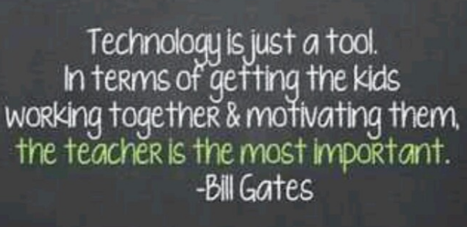
Recap: Making Good AT Decisions
Students needs are fluid and ever changing
On-going, collaborative, functional, dynamic AT decisions made in the customary environment best supports student success
School teams are critical to the success of student’s use of AT
After all, AT is not just about technology – AT is about improving the lives of people with disabilities
  And we do that together!

Slide 31
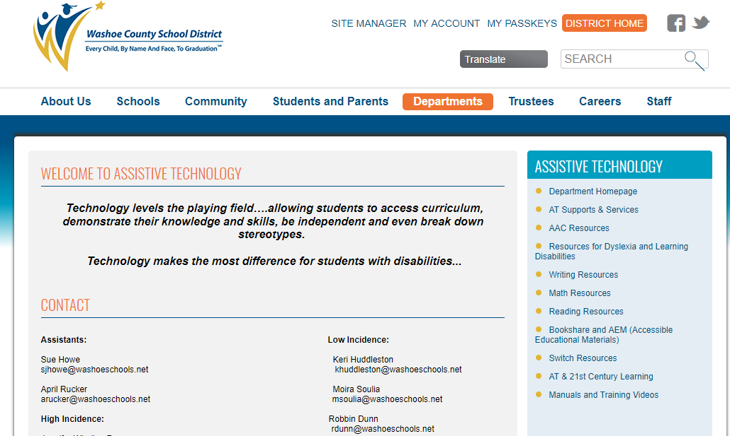
Resources
Our website has many resources….we update on a regular basis
  Washoe County School District/Departments/Assistive Technology
    https://www.washoeschools.net/Domain/278

Slide 32

Sources:
  U.S. Department of Education, Office of Special Education Programs’ (OSEP’s) IDEA website http://idea.ed.gov/explore/view
  Wrightslaw http://www.wrightslaw.com/idea/
  Engler, Teri. Assistive technology in special education: identifying student needs, responding to parent requests, and other compliance issues. Palm Beach Gardens, FL: LRP Publications, 2013.
  SETT: http://www.joyzabala.com/Documents.html
  AEM: www.aem.cast.org
  Bookshare: www.bookshare.org
  WCSD AT Department: https://www.washoeschools.net/Domain/278
  \

